Slide 1
Hotel Review Parsing: Pre and Post Pandemic
Data Science Masters Capstone
DATS 6501
Mariko McDougall

Slide 2
Index

Slide 3

Introduction
The hotel industry, worth over 240 billion dollars globally*, was highly impacted by the Covid-19 pandemic. Due to both health concerns and travel restrictions, occupancy declined more than 11%, and 4.4% of hotels permanently closed in 2020**.
Given the increased competition for limited customers, knowing what factors have the highest impact on a visitor’s experience is critical to maintaining high review scores, satisfaction and occupancy.

Slide 4
Problem Statement
Discerning critical factors may be particularly important now, as customer expectations and requirements may have shifted during the pandemic. For example, sanitation practices are now on the forefront of customers’ minds, where previously they may have had less of an impact on reviews.
Factors will be compared from reviews written both before and during the pandemic, to discern if priorities have changed.

Slide 5
Literature Review

Slide 6
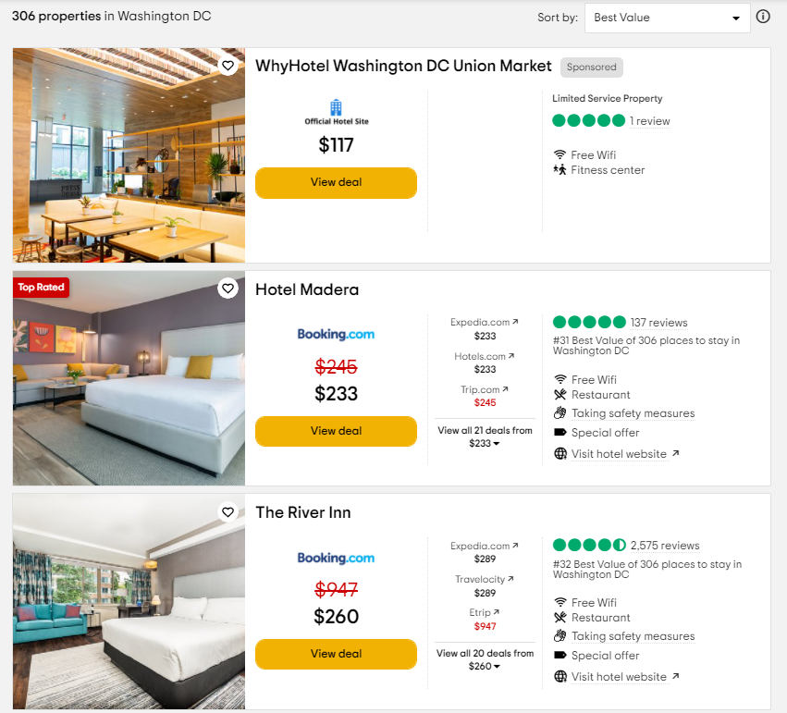
Dataset

Slide 7
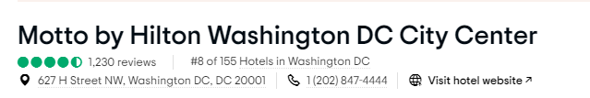
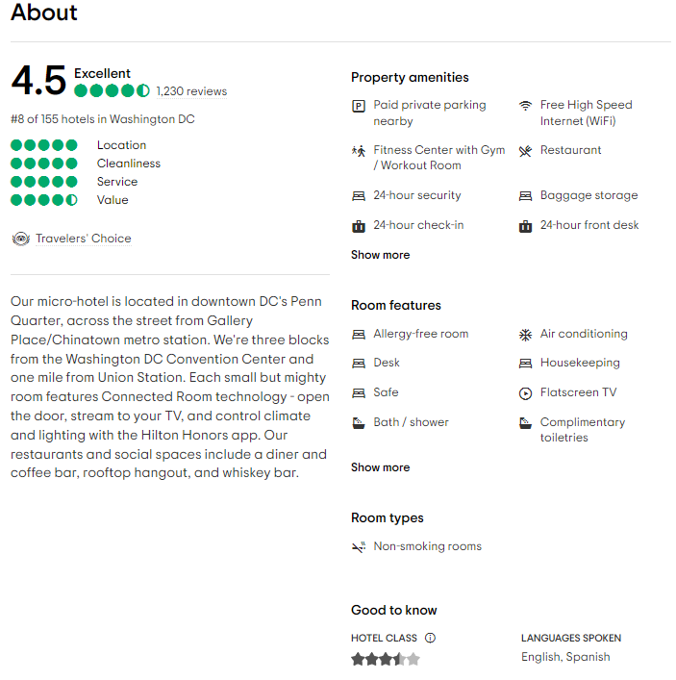
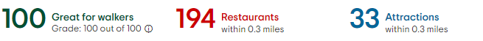
Dataset

Slide 8
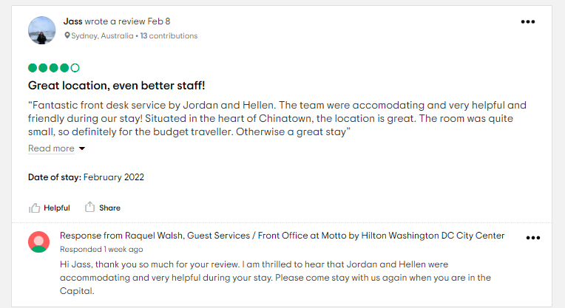

Slide 9
Data Preprocessing

Slide 10
Data Visualizations

